Slide 1
Wedgie composition
Turbidite (mostly greywacke)
Notes:
Although greywacke is the dominant sediment type accreted to the wedge, …

Slide 2
Wedgie composition
Turbidite (mostly greywacke)
Mafic material
Notes:
… a large amount of mafic material was also added to the wedge.

Slide 3
Mafic Sources
Oceanic crust
Seamounts
Forearc basement
forearc thrust
Notes:
Mafic components derive from tectonically sheared-off seamounts and slabs of ocean crust as well as from forearc basin basement rocks uplifted along forearc thrust faults. When uplifted and exposed at the surface of the wedge, these mafic materials rapidly erode producing …..

Slide 4
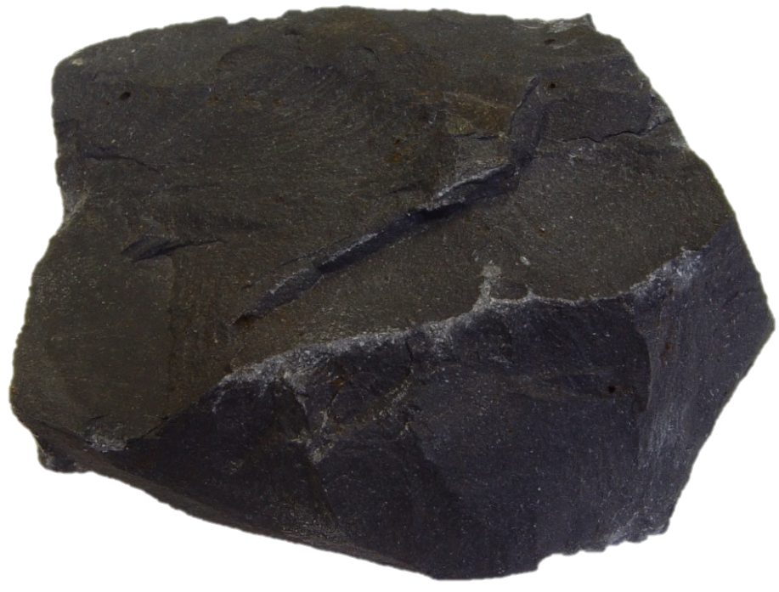
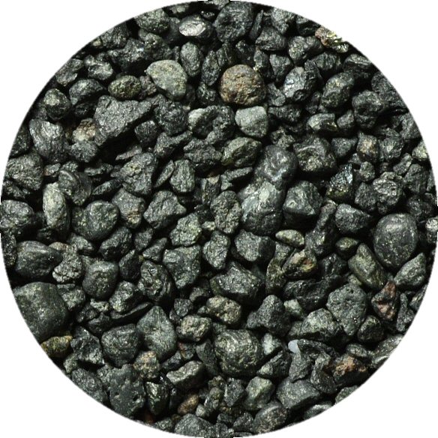
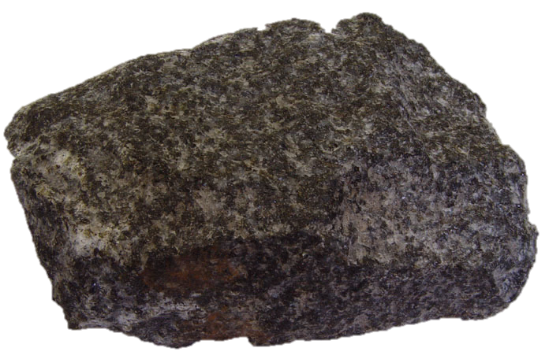
Mafics
Basalt
Gabbro
Basaltic sand and conglomerate
Notes:
… sediment – mostly basaltic sand and conglomerate which quickly traveled down to the wedge and into the trench via sand slides.

Slide 5
Wedgie composition
Turbidite (mostly greywacke)
Mafics (basalt, gabbro, basaltic sand, etc.)
Notes:
So now we add a second component to the wedge – mafics. Together with greywacke, these two components account for about 90% of Catalina’s wedge by volume.

Slide 6
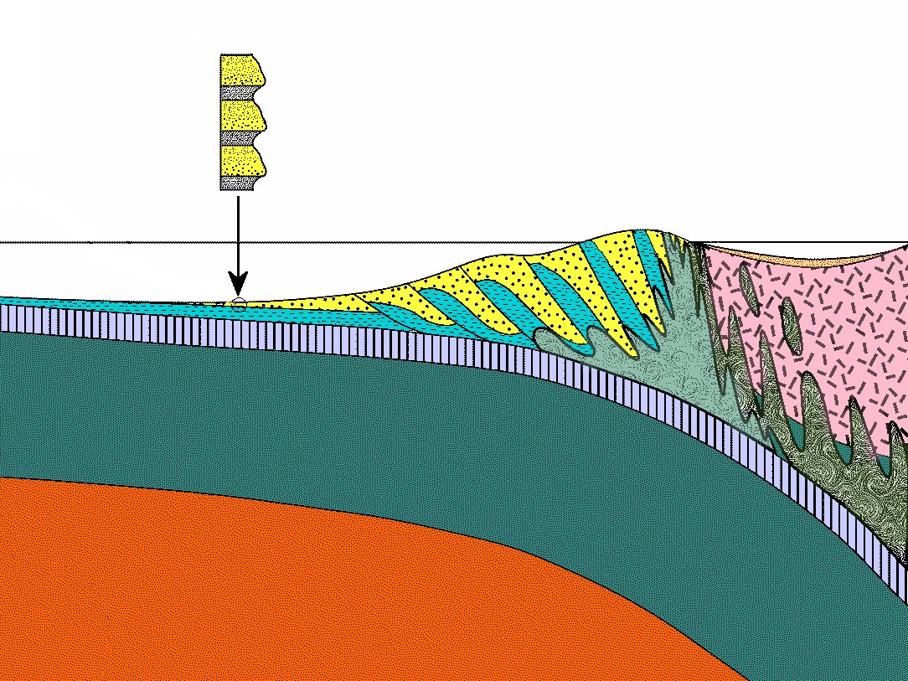
Turbidite
Pelagic
Sediments
subduction
Klamath?
Mélange
Notes:
But subduction of the oceanic crust keeps thrusting a variety of “pelagic” (open ocean) sediment types into the wedge as well.

Slide 7


Notes:
The process works a little like this. Imagine these cards as representing a layer of pelagic strata deposited on the ocean floor offshore from an accretionary wedge.

Slide 8

Notes:
Now place another card on top of each of these …

Slide 9
Notes:
…

Slide 10
Notes:
...

Slide 11
Notes:
…. to represent a layer of turbidite spread-out by a turbidity current or less commonly – basaltic sand. Now let’s push the two-card packets under the adjacent packet to the right.

Slide 12
Notes:
From top to bottom, the original pair of layers will be duplicated repeatedly and the pile of sediment becomes greatly thickened.

Slide 13
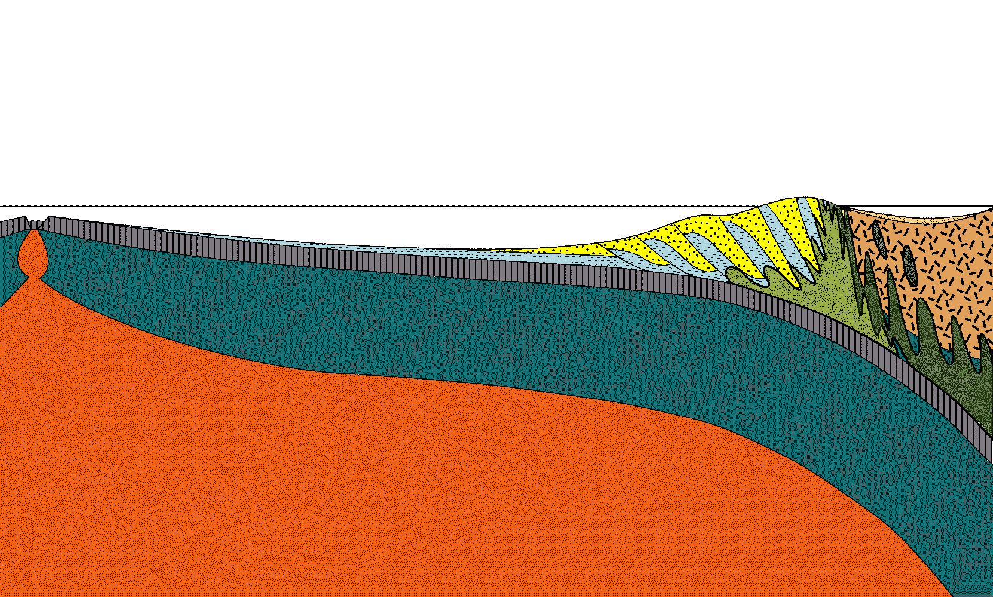
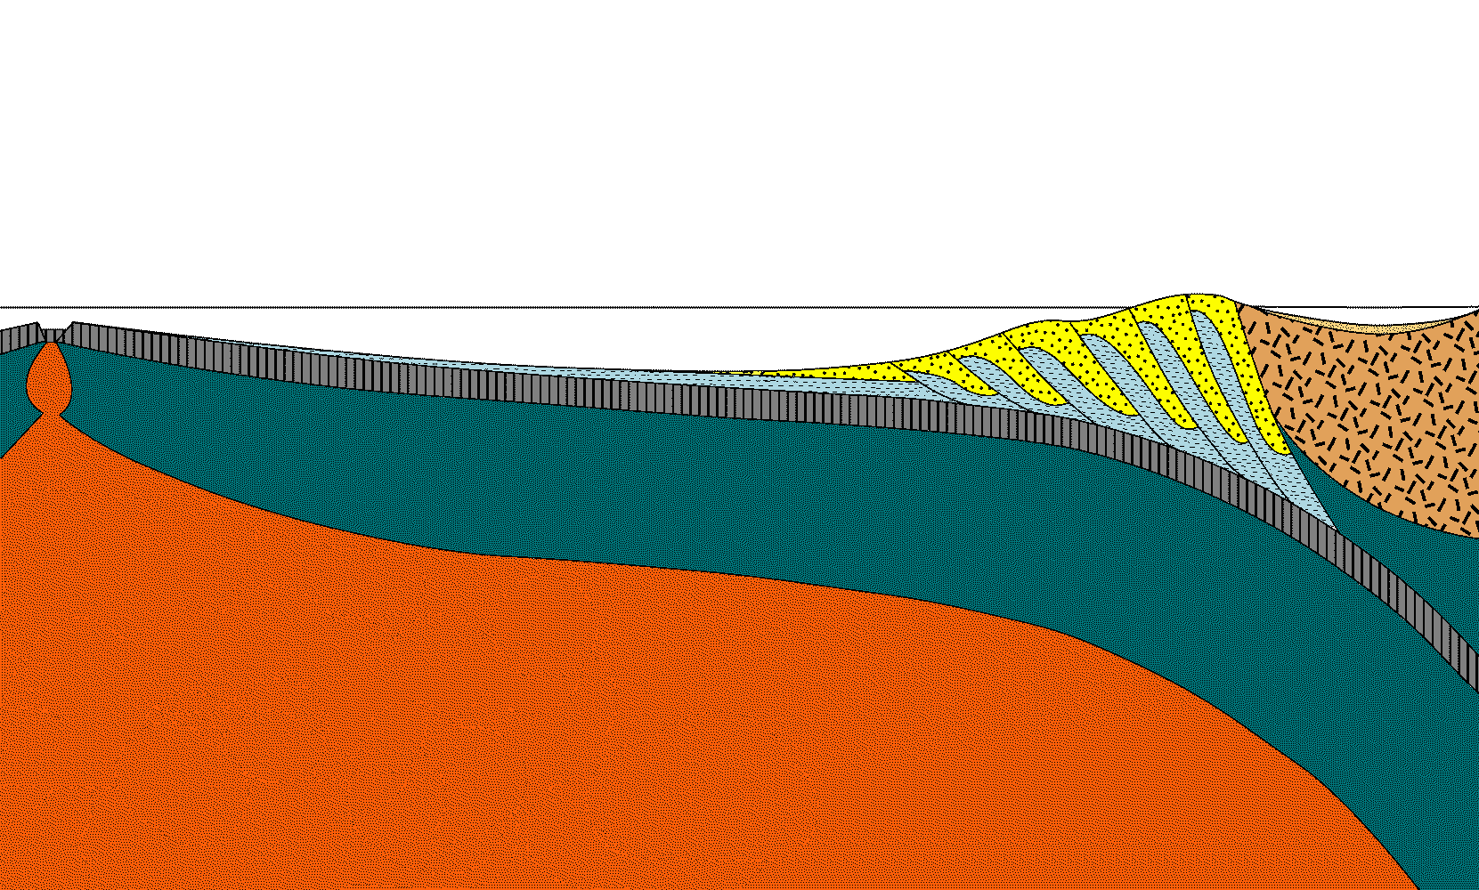
Notes:
The continual addition of new sediment to the base of the wedge eventually lifts packets of older sediment to the surface …

Slide 14
Notes:
… where it can be washed into the ocean, ...

Slide 15
turbidity current
Notes:
… carried out to sea by turbidity currents and sand slides ...

Slide 16
Notes:
…and once again worked to the bottom of the accretionary wedge by subduction.

Slide 17
4-20 million years
Notes:
Thus turbidite, basaltic sand and pelagic sediment become thoroughly shuffled, folded, blended and recycled within the accretionary wedge.

Slide 18
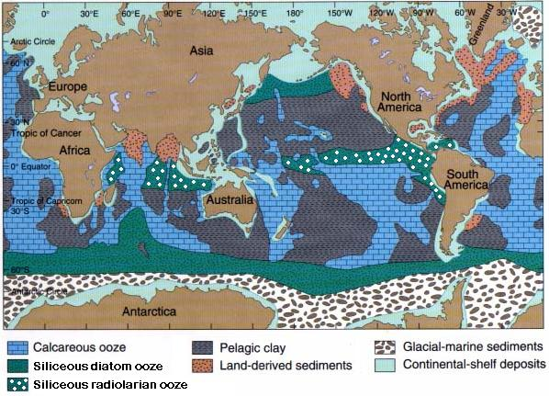
Pelagic Clay
Pelagic Clay
Siliceous Ooze
Calcareous Ooze
Notes:
To complicate the situation further, there are three distinctly different subtypes of pelagic sediment – pelagic clay, siliceous ooze and calcareous ooze.

Slide 19
Pelagic Clay
Notes:
Pelagic clay is the “default” pelagic sediment, meaning that it always exists to some extent in the open ocean, but it may be significantly diluted by other components depending on various environmental factors.

Slide 20
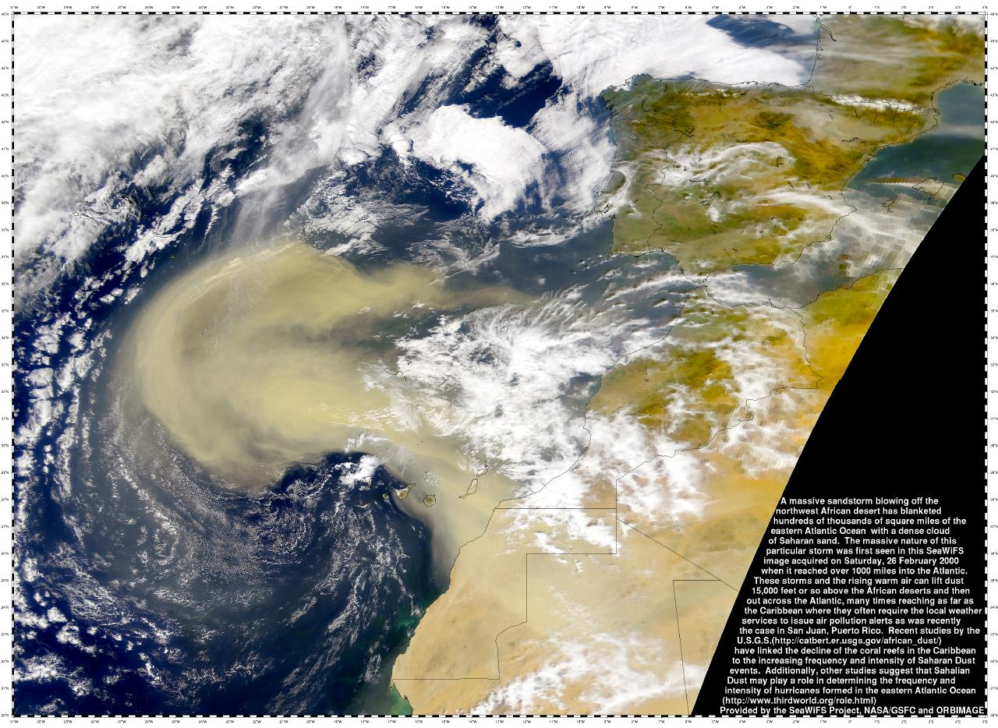
Dust
Saharan Africa
Notes:
Since pelagic clay largely originates from dust blown out to sea …

Slide 21
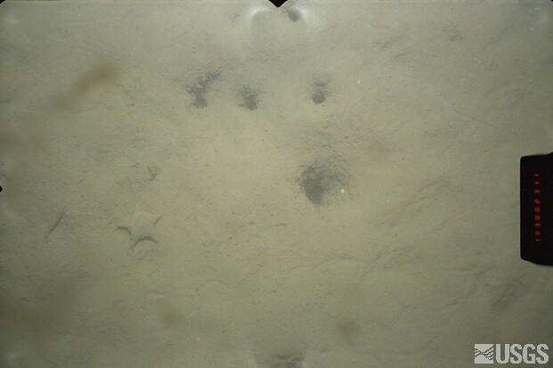
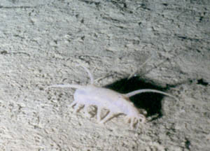
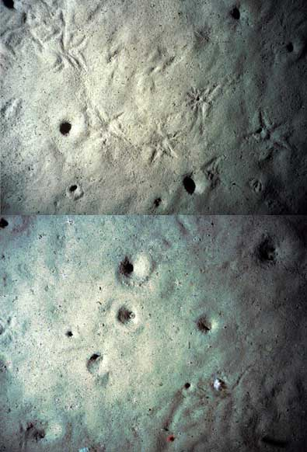
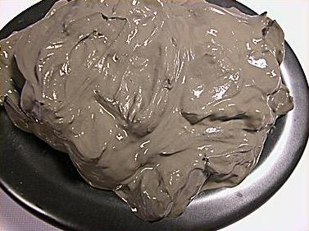
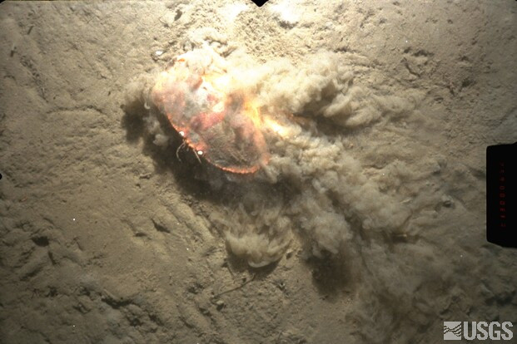
Pelagic Clay
Notes:
… it is extremely fine and settles so slowly that plankton shells almost always accumulate with it.

Slide 22
Calcareous Ooze
Siliceous Ooze
Notes:
When such shells exceed 30% of the sediment, the sediment is called ooze. The shells in siliceous ooze are predominantly made of silica (SiO₂), whereas those in calcareous ooze are made of calcium carbonate (CaCO₃ – aka lime).

Slide 23
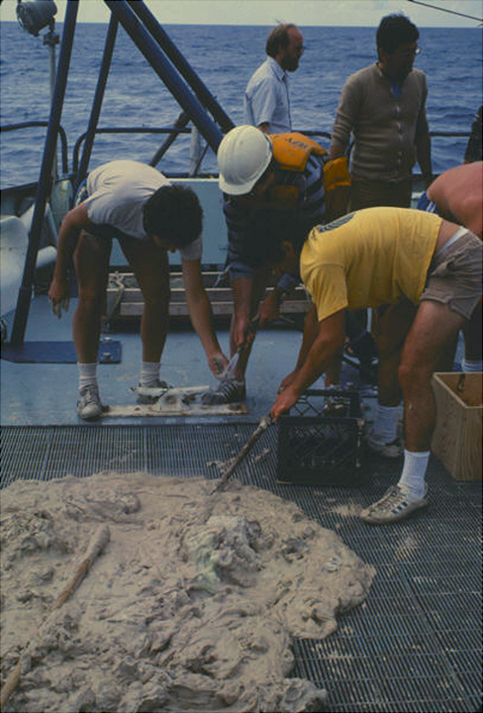
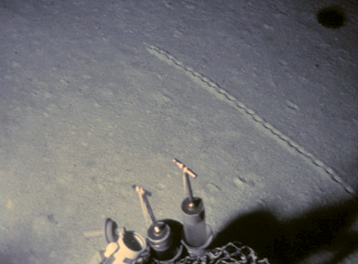
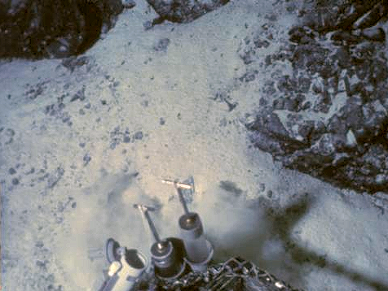
Calcareous ooze
Notes:
Pure calcareous ooze like this is rare. It is almost always mixed pelagic clay and/or siliceous ooze.

Slide 24
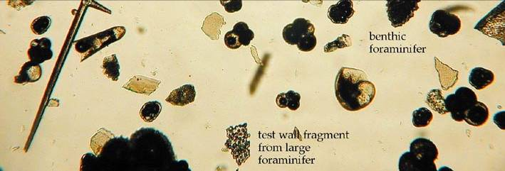
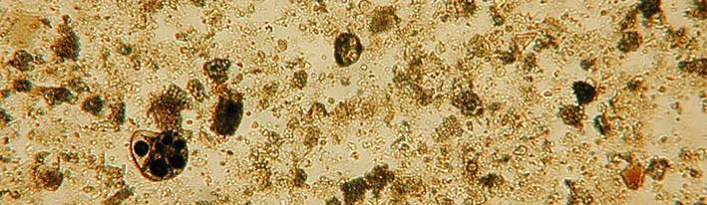
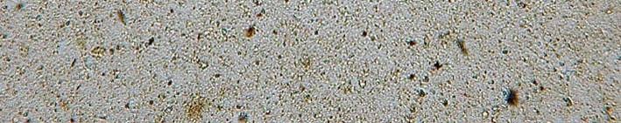
Mostly calcareous ooze
CCCD
Mostly clay
Notes:
That’s because calcareous shells dissolve as they sink but clay and silica do not. Thus there is a certain depth in the ocean, known as the CCCD (calcium carbonate compensation depth), above which mostly calcareous ooze deposits. Below the CCCD mostly pelagic clay deposits unless the surface waters are especially favorable to the production of siliceous plankton, in which case siliceous ooze will deposit.

Slide 25
Siliceous Ooze
Notes:
Such areas typically occur along the equator and near the poles, which explains the distribution of siliceous ooze. Note that diatoms flourish in cold water whereas radiolarians thrive where equatorial upwelling takes place.

Slide 26
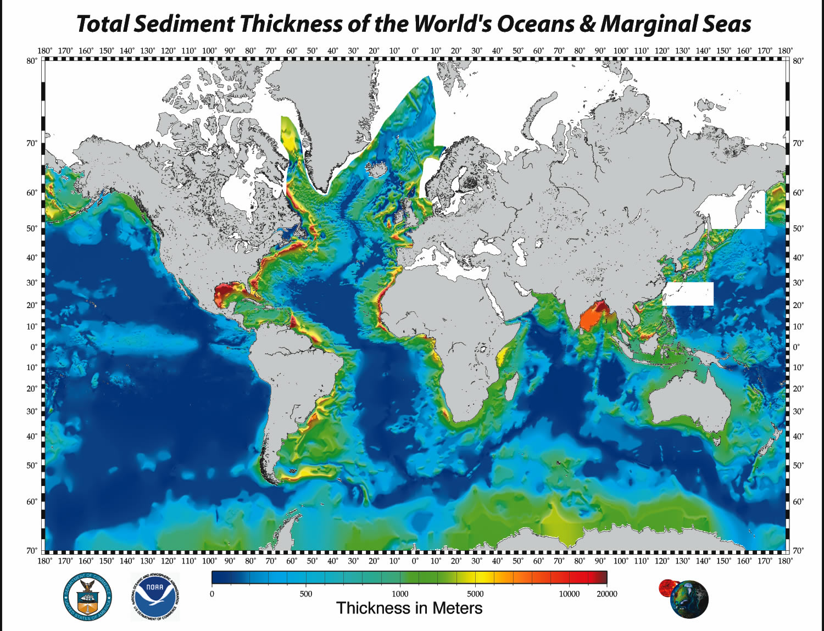
Siliceous radiolarian ooze
Notes:
Also note that near the equator siliceous ooze is roughly 5 times thicker than pelagic clay in the northern Pacific.

Slide 27
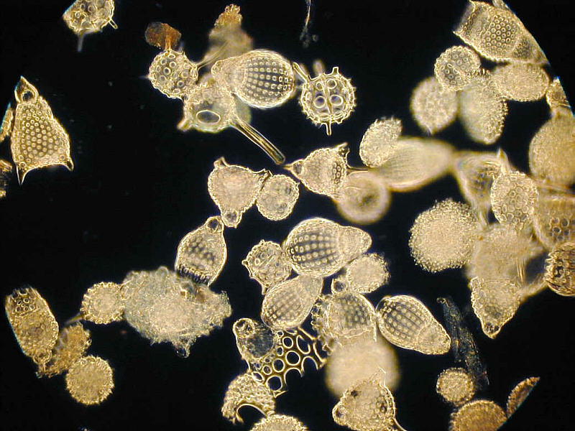
Radiolarians
Notes:
Of the two types of siliceous ooze, it was the radiolarian type which was accreted to the wedge in southern California.

Slide 28
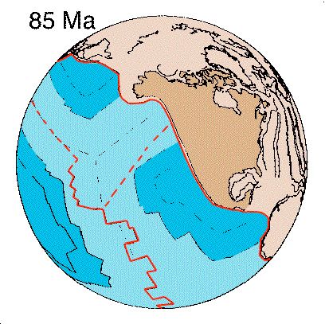
radiolarian ooze
Notes:
That’s because as the Farallon Plate subducted, it moved in a northeasterly direction, eventually transporting sediment that fell on the equator all the way to the wedge. Thus, siliceous radiolarian ooze became the dominant pelagic sediment accreted to the wedge.

Slide 29
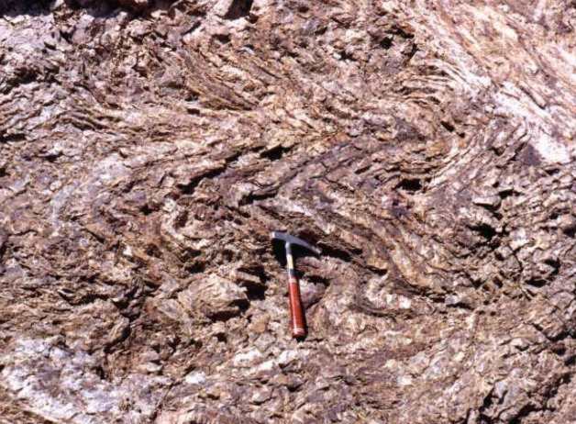
Folded Red Chert (Radiolarian)
Notes:
The highly pliable ooze becomes folded and contorted upon accretion to the wedge and eventually compresses and recrystallizes into the rock “chert”. Red and …

Slide 30
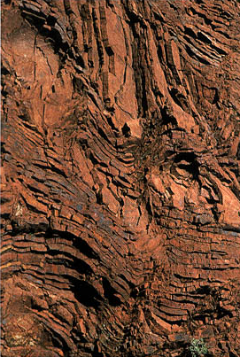
Folded Brown Chert (Radiolarian)
Notes:
… brown colors in chert indicate the presence of iron compounds slowly added to the radiolarian ooze from meteorite and land-derived dust.

Slide 31
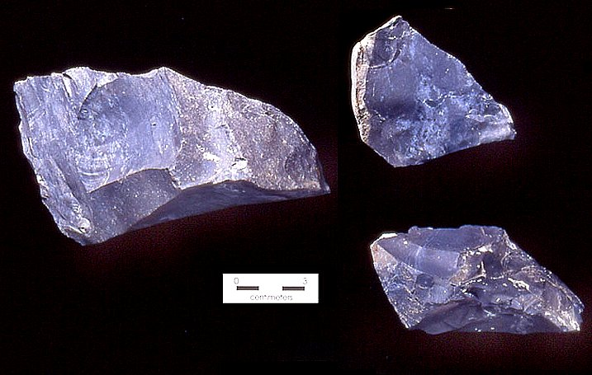
Black chert (organic rich)
Notes:
Black chert contains carbon from organic material.

Slide 32
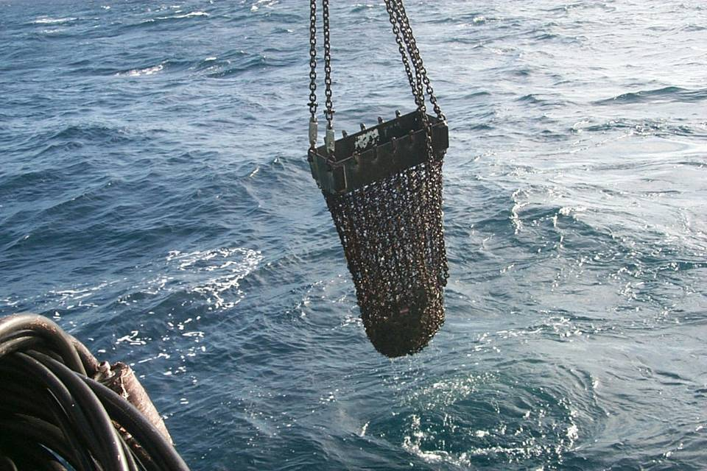
Dredge haul off Nicaragua
Notes:
If we dredge the sea floor off North America, pelagic clay and ooze typically pass right through …

Slide 33
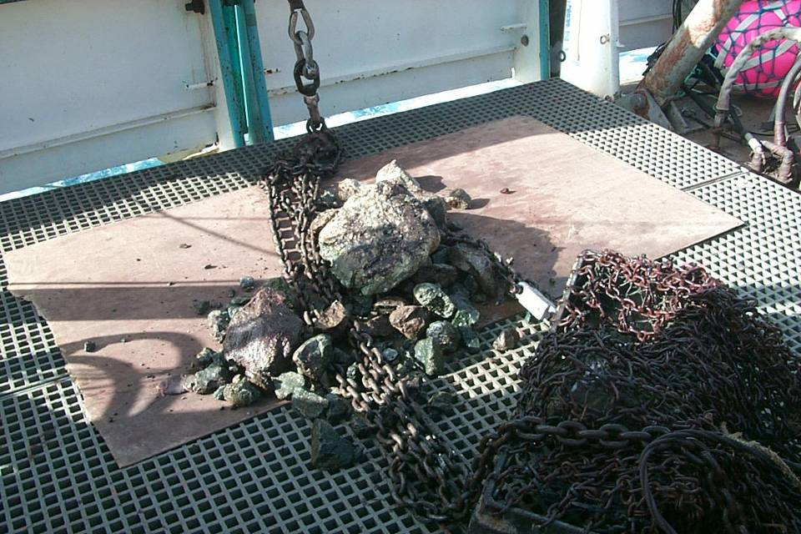
Limestone
Red Chert
Greenstone (basalt)
Wedgie Wannabes
Notes:
… leaving larger fragments of chert and limestone from hardened siliceous and calcareous ooze.

Slide 34

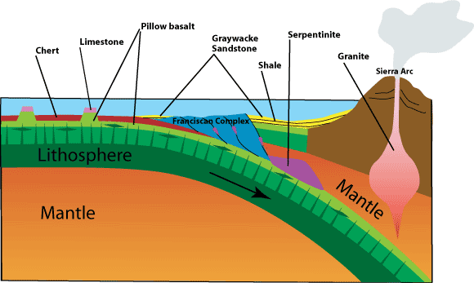
Notes:
The limestone here formed on top of seamounts that were tall enough to rise above the CCCD.

Slide 35
Calcareous Ooze
Notes:
But as you can see, such areas are rare in the north Pacific, …

Slide 36
Siliceous ooze becomes chert
Notes:
.. so chert derived from siliceous ooze near the equator became the dominant pelagic material added to the wedge.

Slide 37
Wedgie composition
Turbidite (mostly greywacke)
Mafics (basalt, gabbro, basaltic sand, etc.)
Pelagics (mostly chert)
Notes:
With the addition of pelagic sediment we have 3 of the 4 ingredients necessary to make “Accretionary Wedgie a la Catalina”.

Slide 38
Upper mantle
(peridotite)
Notes:
The final ingredient comes from the upper mantle just beneath the crust. This part of the earth is made of a rock called peridotite, …

Slide 39
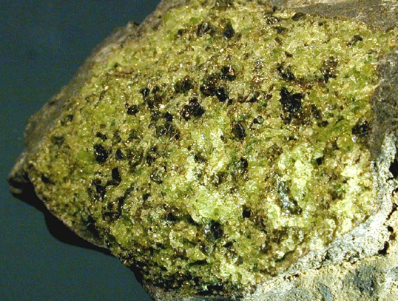
Mantle
Peridotite
Notes:
… which is even higher in Fe and Mg and lower in silica than basalt and gabbro are. The large amount of Fe and Mg in peridotite makes it unstable in the presence of hot, pressurized water, …

Slide 40
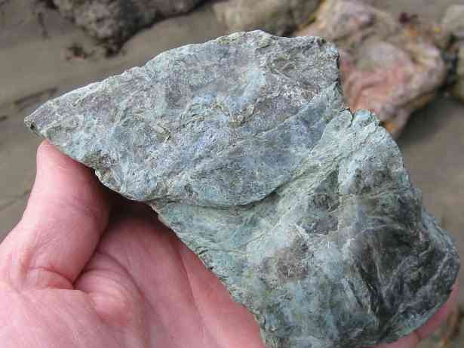
Serpentinite
Notes:
… which alters peridotite into the rock serpentinite (state rock of California).

Slide 41
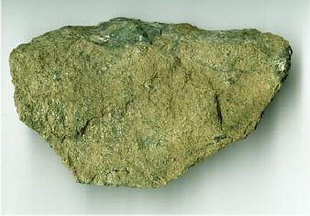
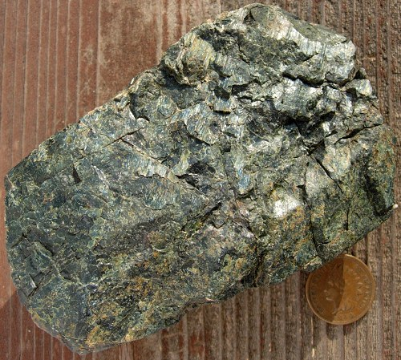
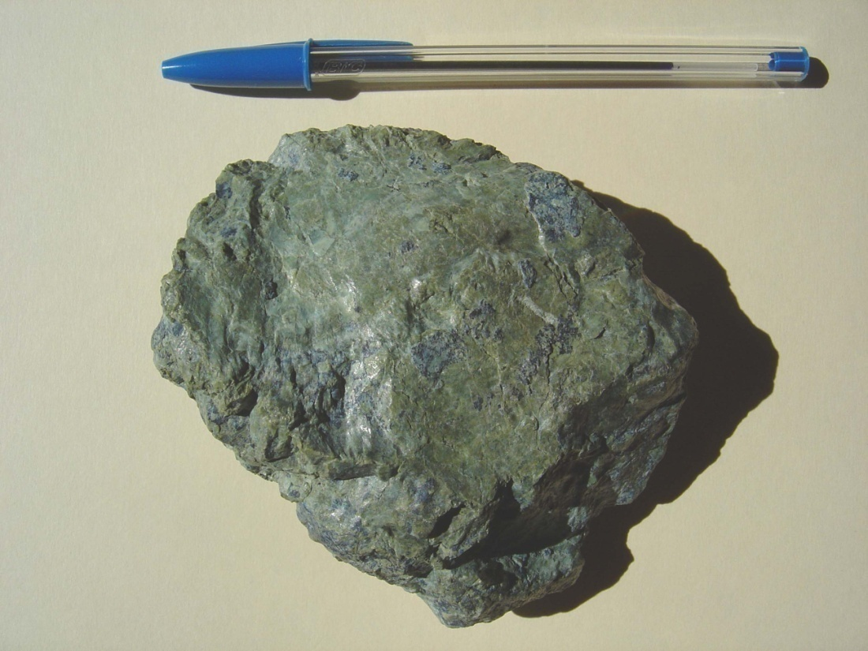
Serpentinite
Notes:
This variously green rock is named after its smooth, snake-skin-like feel and forms from basalt or mantle rocks altered by hot, pressurized water. There are two places where serpentinite can form and later be incorporated into a wedge.

Slide 42
Faults and hydrothermal vents
Ocean crust (basalt and gabbro)
Lithospheric mantle (peridotite)
Notes:
First, hydrothermal systems near oceanic ridges and rises can form serpentinite from either the ocean crust or more typically the lithospheric portion of the mantle there. Uplift along faults associated with ocean ridges and rises aids the process.

Slide 43
H₂O
Notes:
Second, serpentinite can also form due to sea water sweated out of the subducted plate into the wedge of lithospheric mantle above it.

Slide 44
H₂O
H₂O
Notes:
Water is also forced into the base of the accretionary wedge.

Slide 45
Mélange
Notes:
When water is added to rocks under high pressures and temperature, it greatly increases ion mobility and metamorphic reaction rates. Combined with the intense shearing that takes place in the deepest parts of the wedge, the enhanced metamorphism due to the addition of water results in an utterly chaotic mixture of rock types, folds and thrust faults named after the French word for mixture – Mélange. Under-thrusting of additional sediment eventually works the mélange towards the surface.

Slide 46
Serpentinite
Notes:
When infused with hot, pressurized water, the wedge of lithospheric mantle above the subducted plate is far more unstable than the sediments of the accretionary wedge, so the more highly altered rock serpentinite forms.

Slide 47
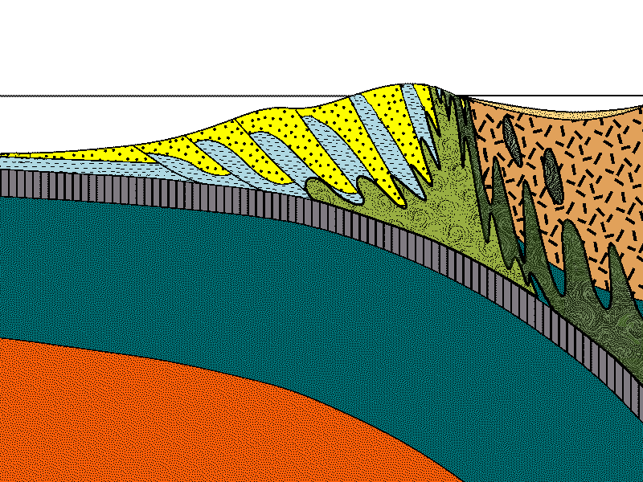
Serpentinite
Notes:
Serpentinite’s high water content makes it relatively buoyant and plastic, …

Slide 48
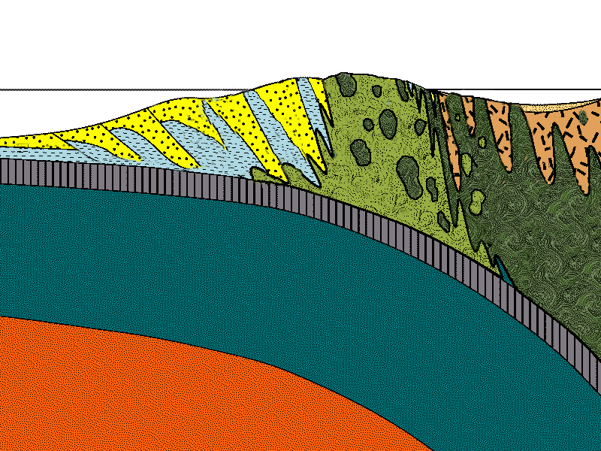
Mélange
Serpentinite
Notes:
… which helps it to rise towards the surface. Serpentinite created in this way is under-thrusted by, and mixed with mélange rocks ...

Slide 49
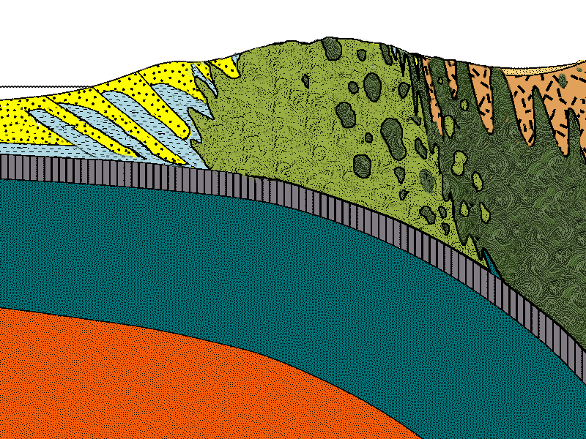
Notes:
... all of which are ultimately worked to the surface …

Slide 50
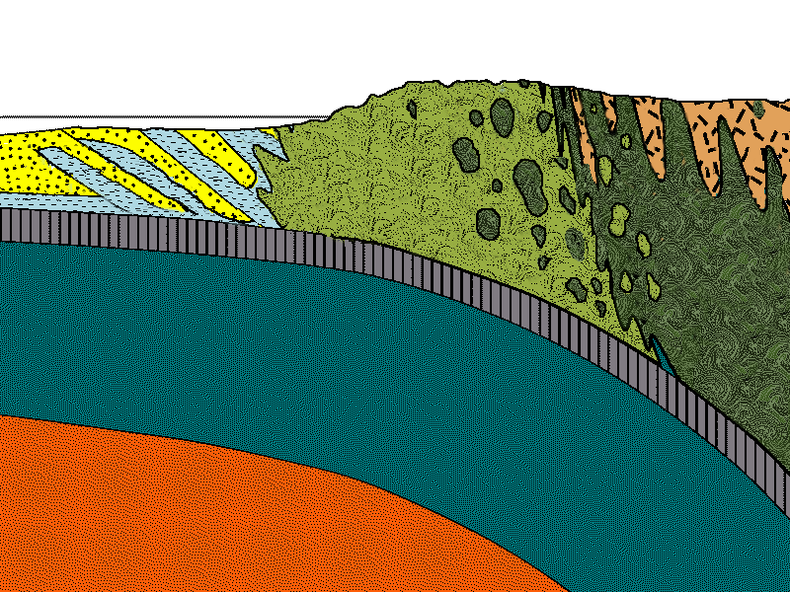
Notes:
… and exposed by erosion.

Slide 51
Wedgie composition
Turbidite (mostly greywacke)
Mafics (basalt, gabbro, basaltic sand, etc.)
Pelagics (mostly chert)
Mantle (serpentinite)
Notes:
The addition of serpentinite to the wedge gives us four very different components: …

Slide 52
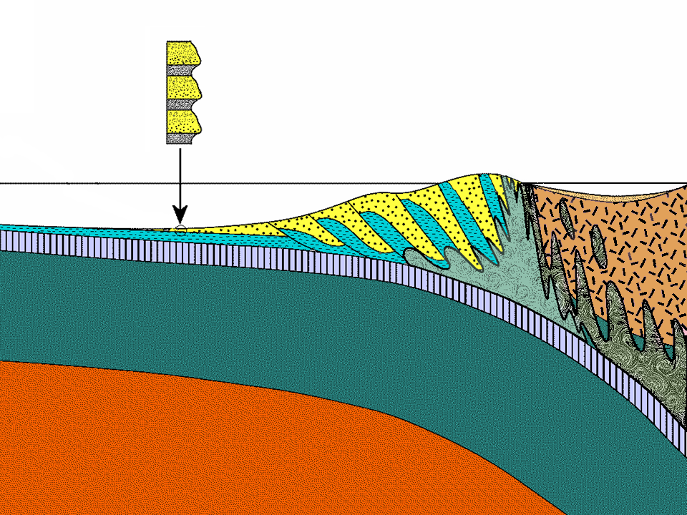
Turbidite (mostly greywacke)
Notes:
… turbidite (mostly greywacke), …

Slide 53
Turbidite (mostly greywacke)
Mafics
Notes:
… mafics from seamounts, ocean crust and uplifted basement rocks below the forearc basin, …

Slide 54
Turbidite (mostly greywacke)
Pelagic
sediment (mostly chert)
Mafics
Notes:
… pelagic sediment (mostly chert), …

Slide 55
Turbidite (mostly greywacke)
Pelagic
sediment (mostly chert)
Serpentinite
Mantle
Mafics
Mantle
Notes:
… … and serpentinized mantle either sheared off the subducted plate or intruded from the mantle wedge above the subducted plate.

Slide 56
Turbidite (mostly greywacke)
Pelagic
sediment (mostly chert)
Mélange
Serpentinite
Mantle
Mafics
Mantle
Notes:
All of these materials become thoroughly blended together into a mélange at the base of the accretionary wedge.

Slide 57
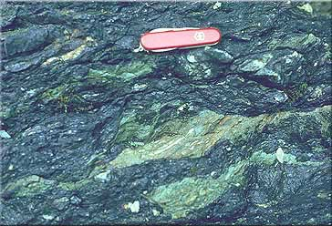
Argillite (clay shale)
Greenstone (basalt)
Sandstone
Mélange close-up
Notes:
The scale of rock fragments in mélange varies from a few millimeters …

Slide 58
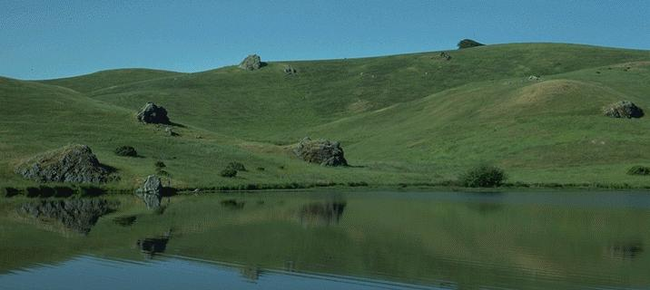
Massive greywacke or chert “knockers” in mélange
Notes:
… to house-size or larger. The sheared and crushed material of the mélange is weak and easily eroded. Large, erosionally-resistant rock masses are called knockers and tend to be massive greywacke or chert.

Slide 59
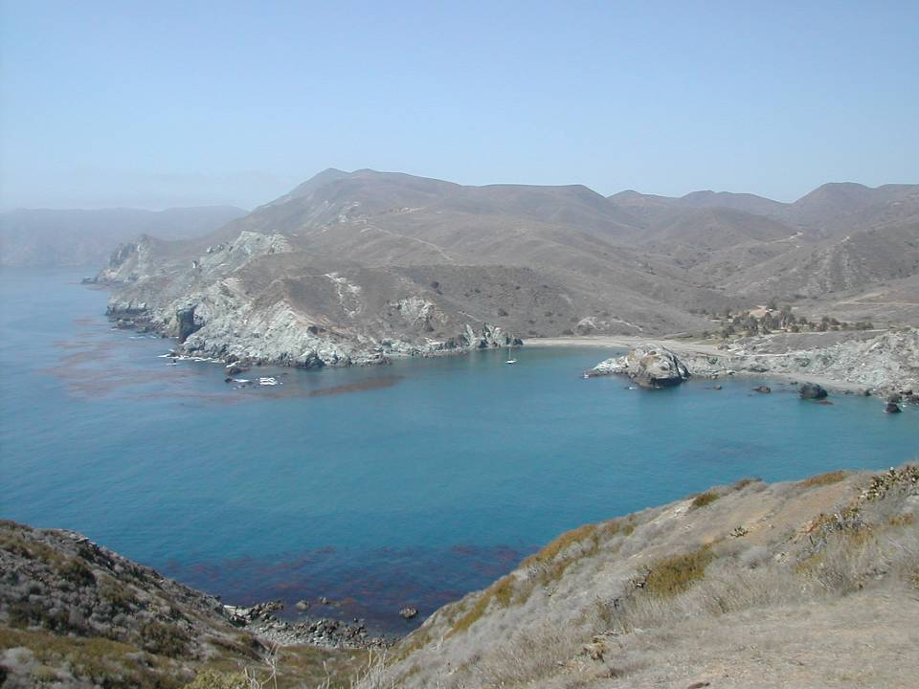
Notes:
Knockers abound on Catalina and are particularly noticeable along the coast where they often form sea stacks.

Slide 60
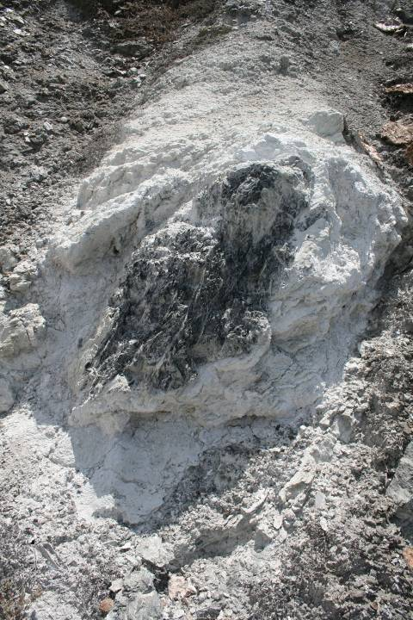
Talc
Notes:
Since knockers move around a lot in the mélange, they commonly encounter major physical and chemical changes. Reaction rims of interesting minerals like talc are formed in this way.

